Slide 1
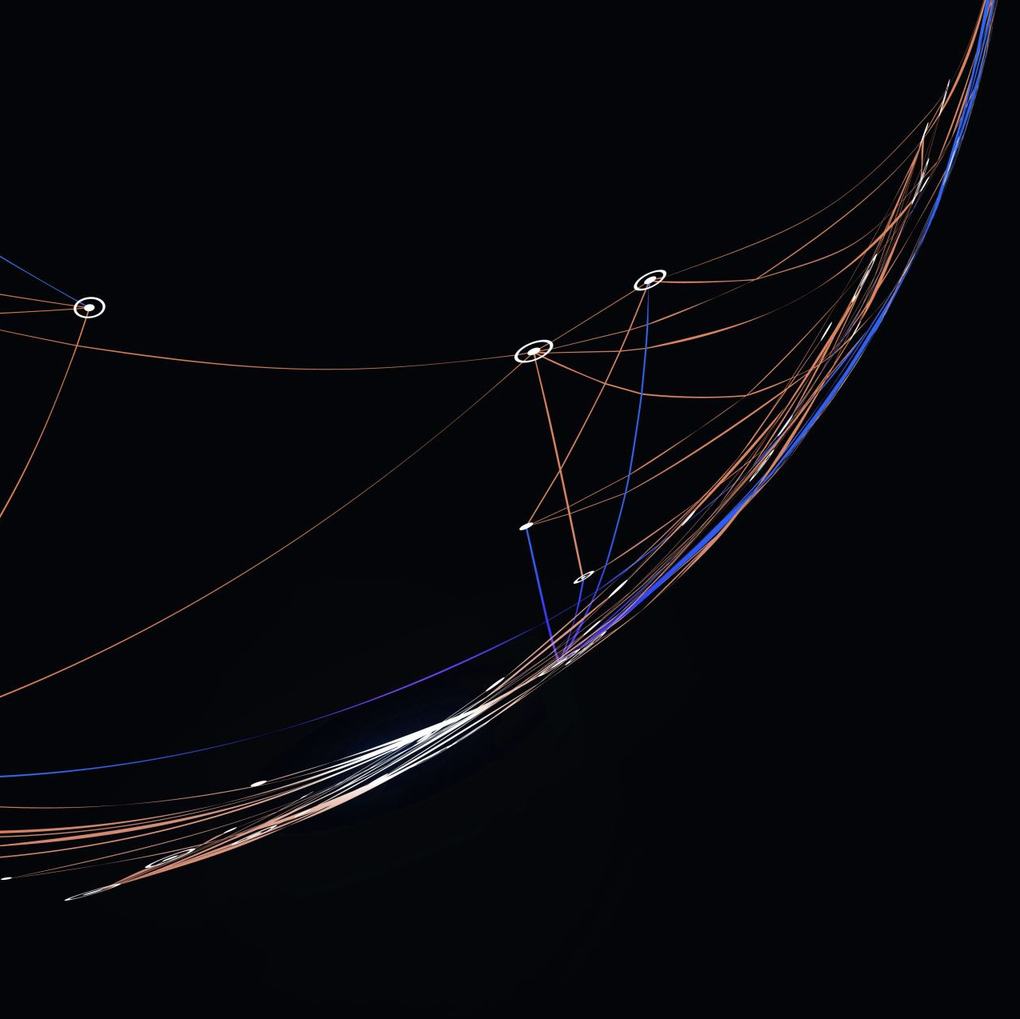
Azure Kubernetes Workshop
Day 1:
Core Kubernetes Concepts

Slide 2
Agenda
Introduction to Kubernetes
Kubernetes Clusters
Pods, Replica Sets and Deployments
Deployment Strategies
Networking Services
Namespaces
ACR
Azure Monitor, Log Analytics workspace
Container Insights

Slide 3
What is a container?
Containers
Containers
VM
VM
App1
App2
App1
App1
Binaries & libraries
Binaries & libraries
Binaries & libraries
Binaries & libraries
Guest OS
Guest OS
Virtual machines
Containers
Virtualize the hardware
Virtualize the operating system
VMs as units of scaling
Applications as units of scaling

Slide 4
The benefits of using containers
Agility
+
Ship apps faster
Portability
+
Easily move workloads
Density
+
Achieve resource efficiency
Rapid scale
+
Scale easily to meet demand

Slide 5




Kubernetes: deploy and manage containerized workloads/services at scale
Kubernetes is…
Portable Public, private, hybrid, multi-cloud
Extensible Modular, pluggable, hookable, composable
Self-healing Auto-placement, auto-restart, auto-replication, auto-scaling
Flexible Facilitates both declarative configuration and automation
Enterprise-ready Supported by a large, and growing ecosystem

Slide 6
Kubernetes is complex
Agent pools
User
2
Control Plane: manages the agent nodes and the pods in the cluster
api-server: front end of the Kubernetes control plane; exposes Kubernetes API
controller-manager: runs the controller processes
scheduler: tracks newly created pods and selects node to run them on
etcd: stores the state of the cluster (config, running workloads status, etc.)
Agent nodes: run your application workloads
Pods: a collection of containers co-located on a single machine
kube-proxy: a network proxy that runs on each node in a cluster
kubelet: agent that runs on each node in a cluster; ensures containers are running in a pod
Containers: software responsible for running containers
Agent node
kubelet
kube-proxy
Internet
1
Control plane
Container runtime
api-server
Pods
Pods
Containers
Containers
controller-manager
scheduler
Agent node
kubelet
kube-proxy
Internet
replication, namespace, serviceaccounts, etc.
etcd
Container runtime
Pods
Pods
Containers
Containers

Slide 7

Kubernetes on Azure
Kubernetes on Azure
Enterprise-grade by design
Built-in best practices
Multi-layer security
Operational efficiency
Unified management
Proactive and actionable recommendations and support from experts, based on knowledge from thousands of enterprise engagements
Hardened security and layers of isolation across compute resources, data, and networking
Automated provisioning, repair, monitoring, and scaling gets you up and running quickly and minimizes infrastructure maintenance
Consistent configuration and governance across on premises, multi cloud, multi-cluster, hybrid, and edge
Built for enterprises
World-class developer tools and a broad ecosystem to meet the diverse needs of enterprises

Slide 8
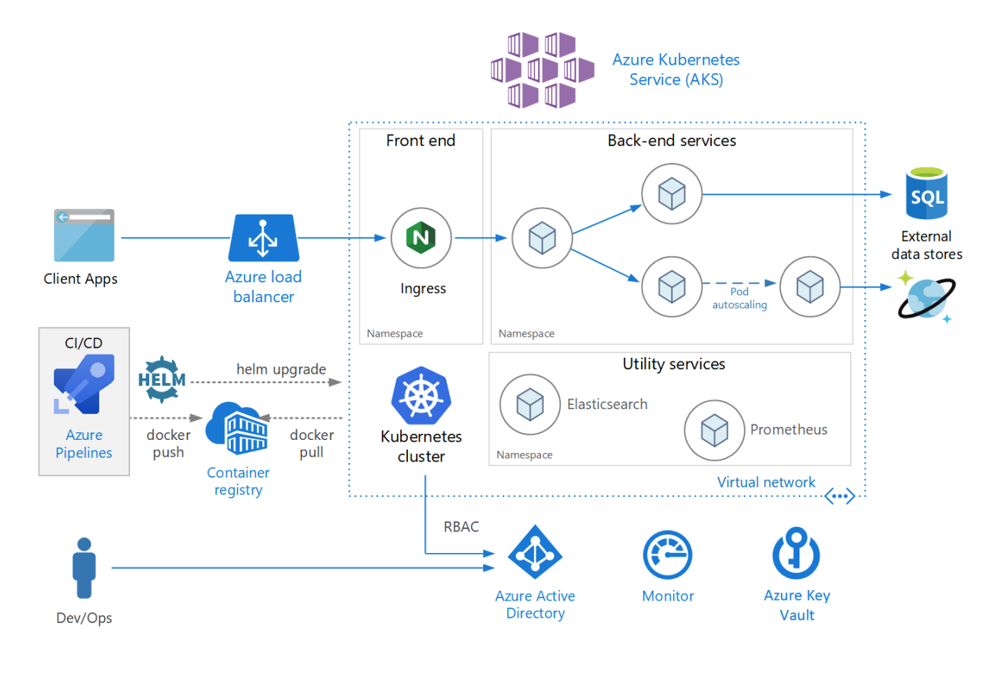
Azure Kubernetes Service (AKS)
Azure Kubernetes Service is the Microsoft solution for hosting Kubernetes as a managed PaaS service.
AKS is highly integrated with other Azure Services like Azure Container Registries (ACR), Azure Disk, Azure File Shares, Azure SQL, Azure AD, Azure Monitor, Azure Key Vault, and many more

Slide 9
Azure Kubernetes Service (AKS)
AKS automates provisioning, upgrading, monitoring, and scaling with, a simpler development-to-production experience, and enterprise-grade security and governance.
By providing Kubernetes as a managed service, AKS abstracts the complexity and operational overhead of managing Kubernetes.
Unlike some cloud providers, Azure doesn’t charge an hourly fee per instance AKS running. An Azure Kubernetes Service instance is completely free!
The only costs of running an AKS cluster are based the resources the cluster uses (nodes, public IPs, etc.) and availability zones, if any.
You have full control over the cluster’s cost based on the size and type resources you choose to add to it and how available do you need your cluster to be.

Slide 10
Installing AKS
There are multiple ways to create/upgrade Azure Kubernetes Service:
Azure Portal – A web-based UI that allows you create AKS clusters with the most commonly used settings (not all settings are available in the Azure Portal). Good for training and creating development clusters.
Azure CLI – A cross-platform command-line interfaces that allows you to configure ALL AKS features and settings. Use when creating production clusters.
Bicep/Terraform – Infrastructure as code tools that lets you declaratively define the configuration of your clusters. Use to deploy multiple clusters and supporting services.

Slide 11
Kubernetes Version
Kubernetes in an open-source application hosted on GitHub.
Major and minor releases are released frequently.
Major release every 3 months
Minor (patch) releases for 12 months after major release.
When creating Azure Kubernetes Service cluster, you need to decide which version of Kubernetes you want to install as your control plane.
You can upgrade your cluster to a newer version later.
The default version selected in the Azure Portal is 2 releases back from the latest stable (non-preview) release.
The nodes must be running a version of Kubernetes that is equal to or less than the current version on the control plane

Slide 12
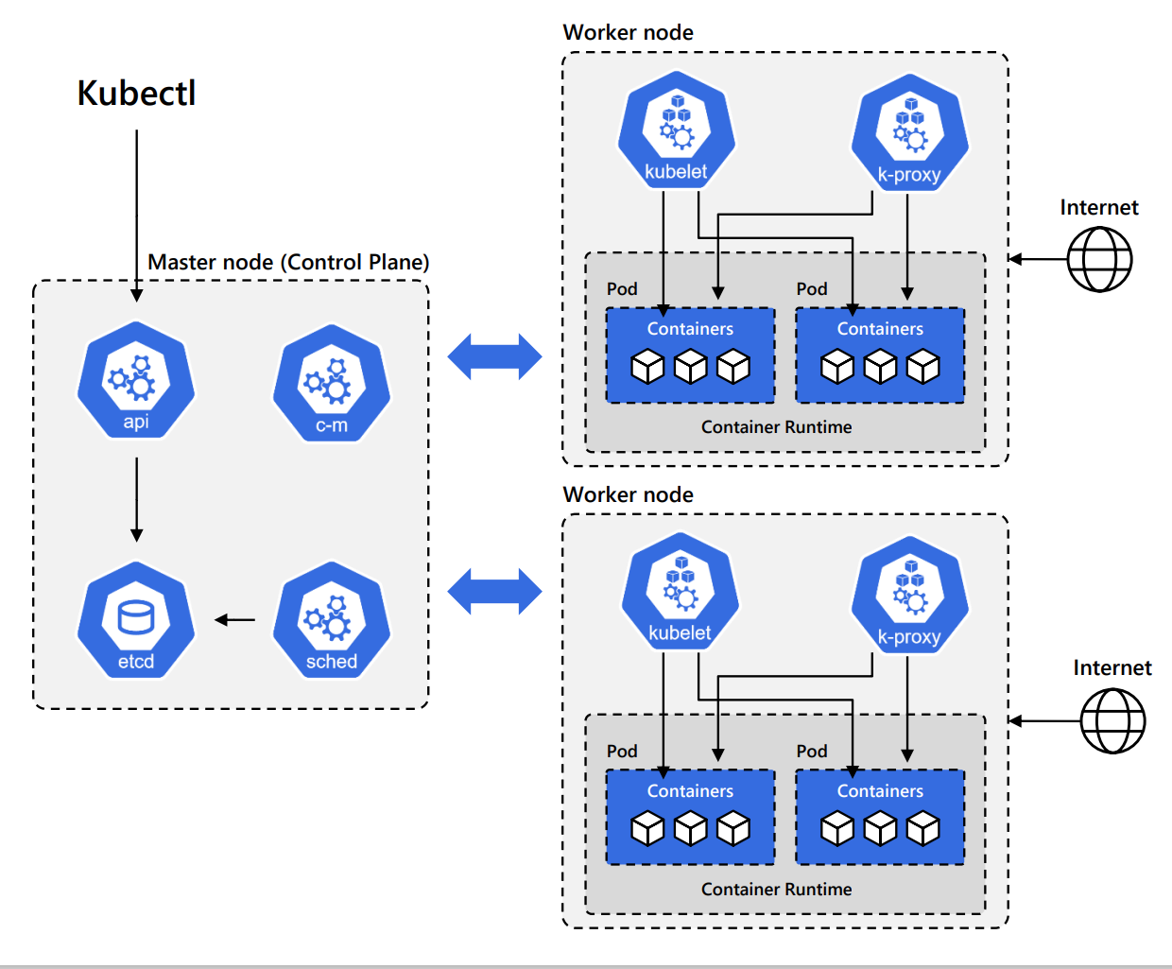
Managing a Kubernetes Cluster
Since Kubernetes is a simple REST API application, you can manage a cluster by making REST calls to the API Server.
Example HTTP Request: GET /api/v1/namespaces/default/pods/{name}
However, it’s much easier to use the official Kubernetes client command-line utility (kubectl), instead

Slide 13
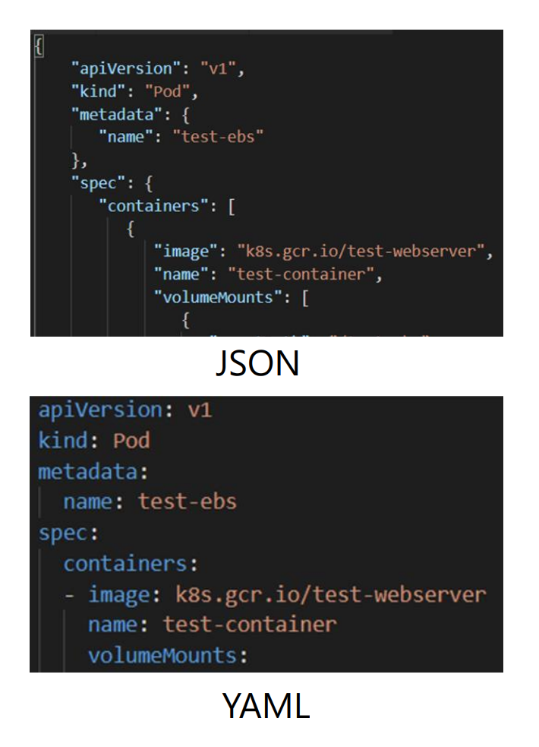
Declaring Kubernetes Object in YAML
When working with REST API applications like Kubernetes, you expect to exchange JSON data.
However, when using kubectl, you provide a desired state configuration using the YAML markup language (Yet Another Markup Language) instead.
YAML uses indentation instead nested curly brackets ({}) to define structure and hierarchy.
kubectl converts your YAML to JSON when making communicating with the Kubernetes API Server.

Slide 14
Kubectl
Kubectl is the official command line utility used to interact with the Kubernetes cluster and its resources.
Common commands include:
Get – Returns a list of objects. Can get all the details for a specific object in yaml or json format.
Example: Get a list of Nodes: kubectl get nodes
Example: Retrieve the YAML definition of a Pod from etcd: kubectl get pod pod-123 –o yaml
Describe – Displays a detailed description of an object and related information from other objects.
Example: Show Details Description of a Services: kubectl describe service/myservice
Logs – Displays the stdout log from a container in a Pod:
Example: kubectl logs pod-123 –c nginx
Exec – Executes a command in container in a Pod:
Example: kubectl exec –it pod-123 –c nginx –- bash

Slide 15
Pods
In Kubernetes, you never directly run a container, instead you run a Pod
A Pod is a “wrapper” around one or more containers.
Pods are the smallest deployable compute units you can create and manage in Kubernetes.
A Pod can manage one or more containers, with shared storage (volumes) and network resources, and a specification for how to run the containers.
Containers running in a Pod share the same IP and ports and communicate using native inter-process communication channels or localhost.
Pods are immutable - if any change is made to the Pod specification (spec), a new Pod is created and then the old Pod is deleted

Slide 16
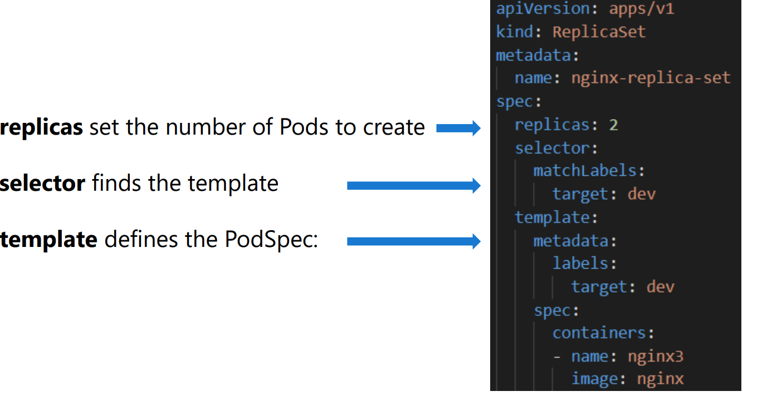
Replica Sets
Containers are created by Controllers through Pods.
A ReplicaSet is a controller whose purpose is to guarantee the availability of a specified number of identical Pods.

Slide 17
AKS Demo
Module1-instructions.pdf
Exercise: Create a Basic Azure Kubernetes Service(AKS) Cluster
Exercise: Creating a Pod Declaratively
Exercise: Adding/Updating/Deleting Labels on a Pod
Module2-instructions.pdf ( Optional)
Exercise: Create AKS Cluster using Azure CLI
Exercise: Create AKS Cluster using Terraform
Notes:
Module1-instructions.pdf
Exercise: Create a Basic Azure Kubernetes Service(AKS) Cluster
Exercise: Creating a Pod Declaratively
Exercise: Adding/Updating/Deleting Labels on a Pod
Module2-instructions.pdf ( Optional)
Exercise: Create AKS Cluster using Azure CLI
Exercise: Create AKS Cluster using Terraform

Slide 18
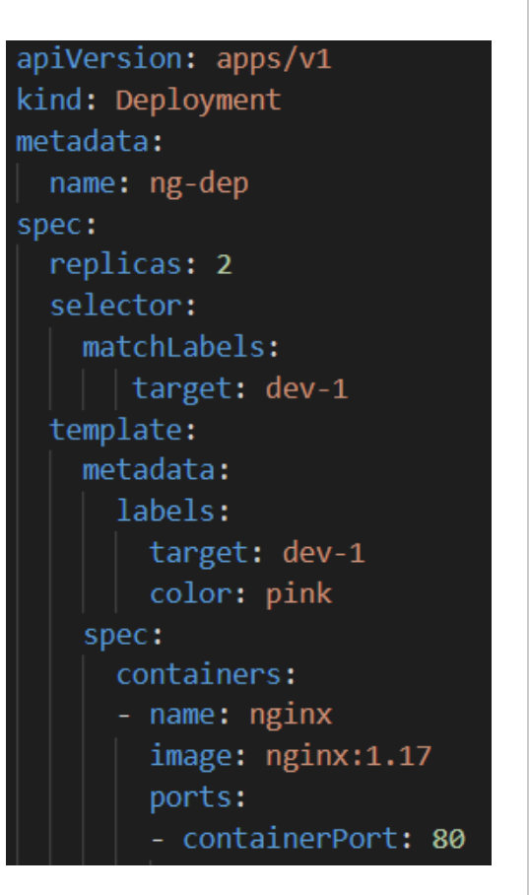
Deployments
A Deployment is a higher-level controller that manages ReplicaSets and provides declarative updates to Pods along with a lot of other useful features.
You describe a desired state in a Deployment, and the Deployment Controller changes the actual state to the desired state at a controlled rate
Deployments provide finegrained control over how and when a new pod version is rolled out as well as rolled back to a previous state

Slide 19
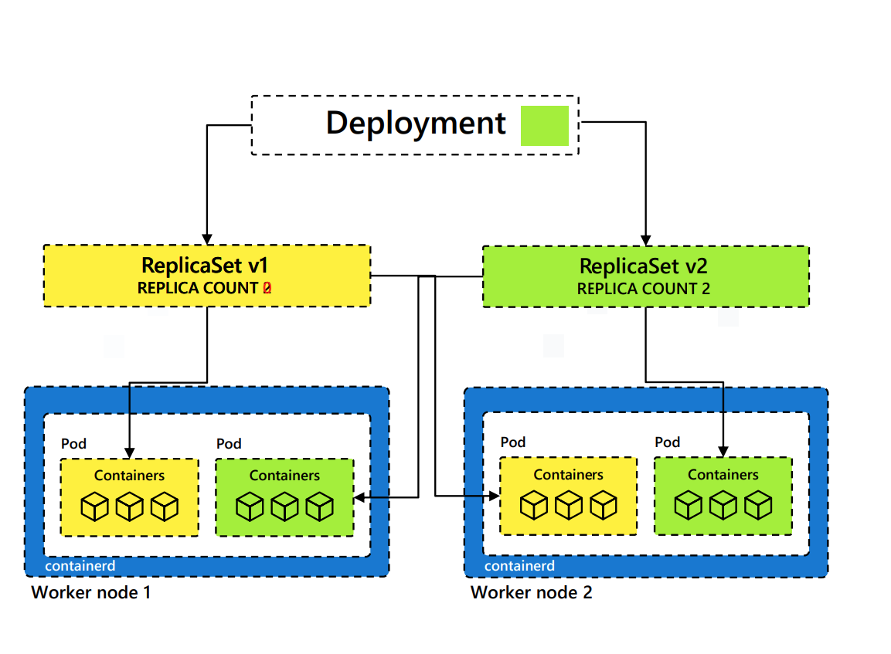
Deployments at Work
Let’s say we are running a deployment with 2 replicas of a pod. For illustration, our deployment is designated with a yellow background.
Developer makes the change to the deployment image tag and to sets the background to green.
The Deployment creates a ReplicaSet v2, which will create 2 new Pods with the updated image.
Once the new Pods are up and running, the Pods attached to ReplicaSet v1 are deleted

Slide 20
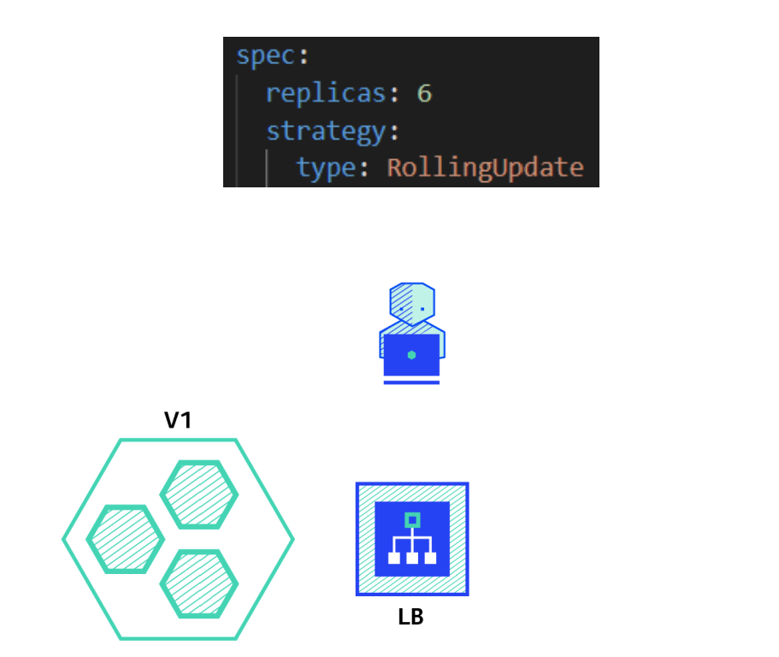
Natively Supported Deployment Strategies
A deployment strategy is a way to change or upgrade an application. The two directly supported Kubernetes deployment strategies are
Rolling Update - Consists of slowly rolling out a new version of an application by replacing instances one after the old version until all the instances are rolled out. This is the default strategy for Kubernetes Deployments when none is specified

Slide 21
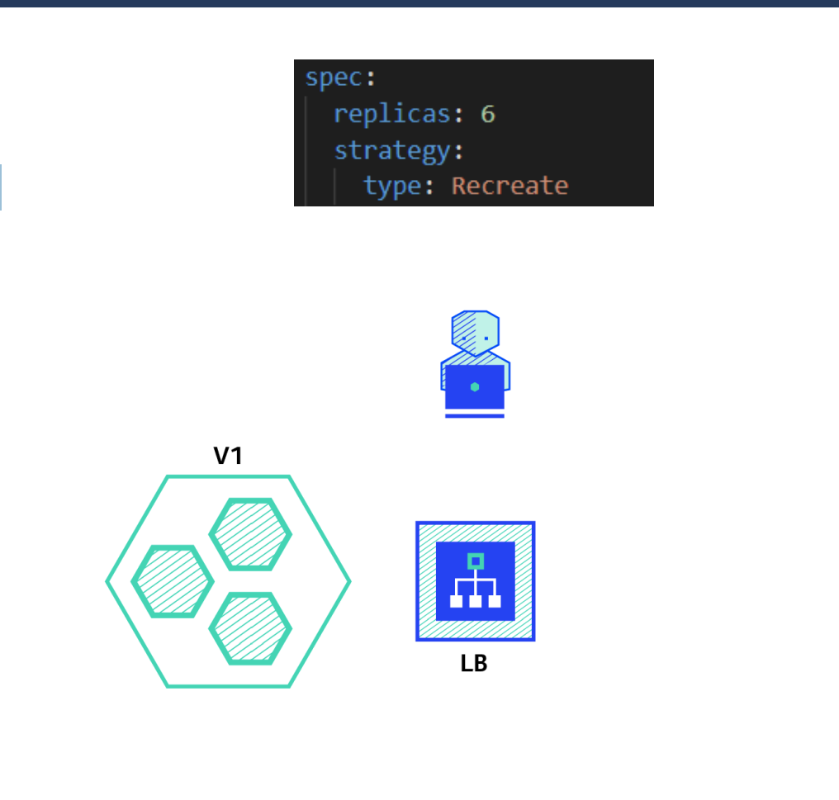
Natively Supported Deployment Strategies
Recreate - Consists of shutting down all instances of the current version, then deploying the new version. This technique implies downtime of the service that depends on both shutdown and boot duration of the application.

Slide 22
Deployment Demo
Module1-instructions
Exercise: Working with Deployments
Notes:
Module1-instructions
Exercise: Working with Deployments

Slide 23
Natively Supported Deployment Strategies
Recreate - Consists of shutting down all instances of the current version, then deploying the new version. This technique implies downtime of the service that depends on both shutdown and boot duration of the application.

Slide 24
Advanced Deployment Strategies
Blue/Green: Version B is released alongside version A , then traffic is switched to Version B
Canary: Version B is release to subset of users , then proceed to a full rollout
A/B Testing: Version B is released to subset of users under Specific condition
Shadow: Version B real-world traffic along aside version A and doesn't impact the response

Slide 25
Expose Cluster
Kubernetes Service & Ingress

Slide 26
Services
A Service is an abstraction that defines a logical set of looselycoupled PODs and a policy by which to access them as a network service.
Use selectors to define which pods to include.
Services load balance traffic to Pod replicas (Layer 4)
Maps external ports to target (container) ports
Exposes Pods to traffic outside the cluster.
Kubernetes creates an Endpoints object with the same name as the Service.
As Pods are deleted and replaced, the Endpoints object is automatically updated with the new Pods’ IP addresses, as soon as those Pods go into a Ready (Running) state.
This allows the Service’s load balancer to immediately know which Pods it has to choose from when routing incoming traffic.

Slide 27
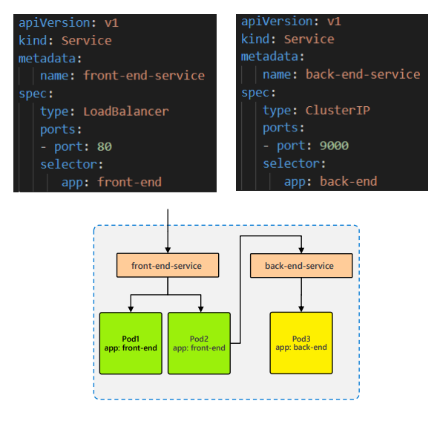
Services at Work
You don't need to modify your application to use an unfamiliar service discovery mechanism.
Unlike Pods, Service names/IPs don’t change, so they can be used for reliable routing configurations.

Slide 28
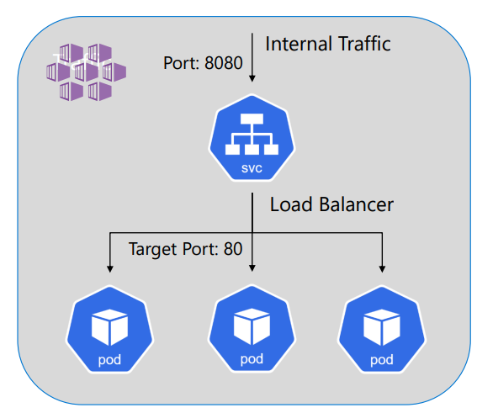
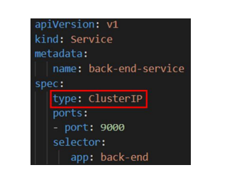
Services Types -ClusterIP
ClusterIP – An internal IP address for use within the Kubernetes cluster.
Used for internal communications between workloads within the cluster.
Default service type when one is not specified.

Slide 29
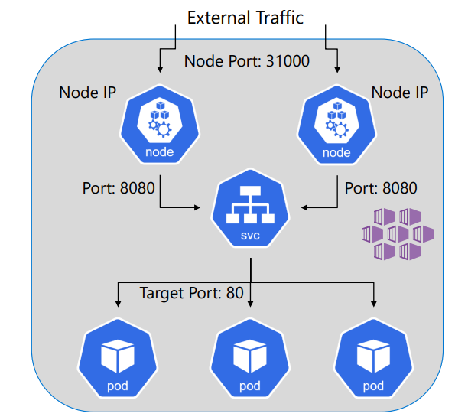
Services Types -NodePort
NodePort - Creates a port mapping to the underlying Node, which allows external access directly to Pods by using the Node IP address (any Node’s IP) and the Node Port.
Used in on-premise Kubernetes clusters to expose services for external access.
Only practical in AKS clusters when the Nodes’ IP addresses are externally accessible, such as for Game Servers. Can be configured during cluster creation using this parameter:
--enable-node-public-ip

Slide 30
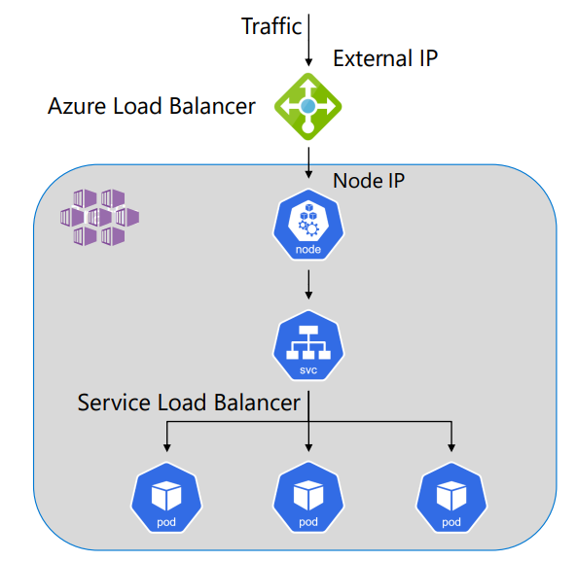
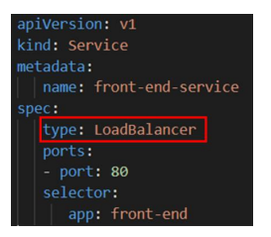
Services Types -LoadBalancer
LoadBalancer – Requests an external IP address (public by default) from the Azure Load Balancer.
Azure creates an IP Address resource and adds it to the load balancer backend pool.
Allow external traffic to reach Pods in the cluster.

Slide 31
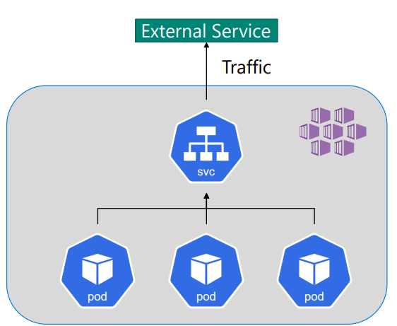
Services Types -ExternalName
ExternalName – A special case of Service that does not have selectors, because it’s used for external access.
An ExternalName maps a Service to a DNS name, for Pods to have consistent routes to external resources

Slide 32
Service Demo
Module1-Instructions
Exercise: Working with Services
Notes:
Module1-Instructions
Exercise: Working with Services

Slide 33
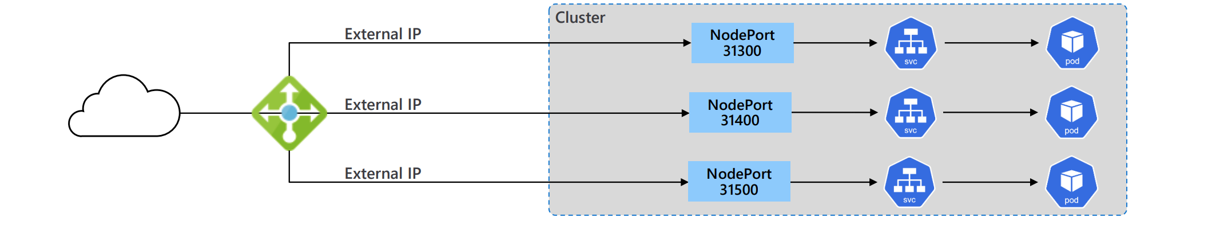
Kubernetes Load Balancer vs Ingress
A Kubernetes Load Balancer maps an external IP to a single service endpoint inside the cluster
Each Kubernetes Load Balancer service requests an external IP address from Azure.
For multiple service endpoints, you need to create multiple Load Balancers and IPs.
If you expose dozens or hundreds of endpoints, this approach doesn’t scale well.

Slide 34
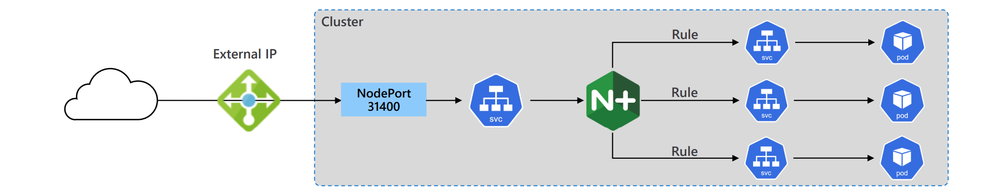
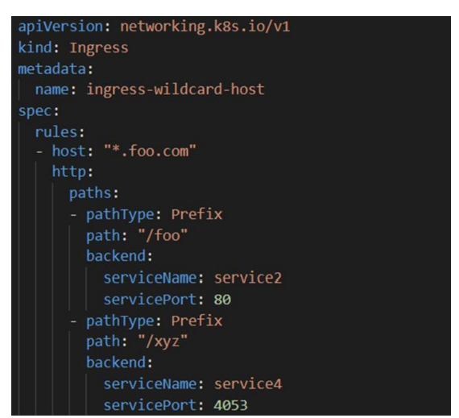
Kubernetes Load Balancer vs Ingress
An Ingress Resource enables routing to internal traffic through a single external endpoint.
Routing rules are defined in Ingresses in each namespace.
A single Ingress Controller combines Ingress rules across all namespaces and routes external HTTP and HTTPS (layer 7 only) traffic to internal Cluster IP services.
Kubernetes does not provide a concrete implementation of an Ingress Controller to perform this routing.

Slide 35
3rd Party Ingress Controller
To support Ingress resources, you must install a 3rd party Ingress Controller.
Kubernetes supports the following popular Ingress Controllers:
The NGINX Ingress Controller for Kubernetes works with the NGINX webserver (as a proxy).
The Traefik Kubernetes Ingress provider is an ingress controller for the Traefik proxy.
The AKS Application Gateway Ingress Controller is an ingress controller that configures the Azure Application Gateway

Slide 36
Ingress Controller Demo
Module3-instructions
Exercise: Using Ingress Resources and Ingress Controller to control external access
Notes:
Module3-instructions
Exercise: Using Ingress Resources and Ingress Controller to control external access

Slide 37
AKS Upgrade Options
Azure offers 3 primary upgrade modes for AKS, which can be configured to be performed automatically if desired.
Node image updates – Azure issues OS image security updates every 1-2 weeks. It’s important that the nodes in an AKS cluster be upgraded frequently to the latest OS images.
Kubernetes Patch upgrades: Kubernetes patches (ex: 1.25.5 -> 1.25.9) are available on a regular basis.
Kubernetes Minor version upgrades: Kubernetes releases minor versions (1.25 -> 1.26) every 3-4 months.
Review the Deprecated API Migration Guide before performing a minor Kubernetes upgrade: https://kubernetes.io/docs/reference/using-api/deprecation-guide/

Slide 38
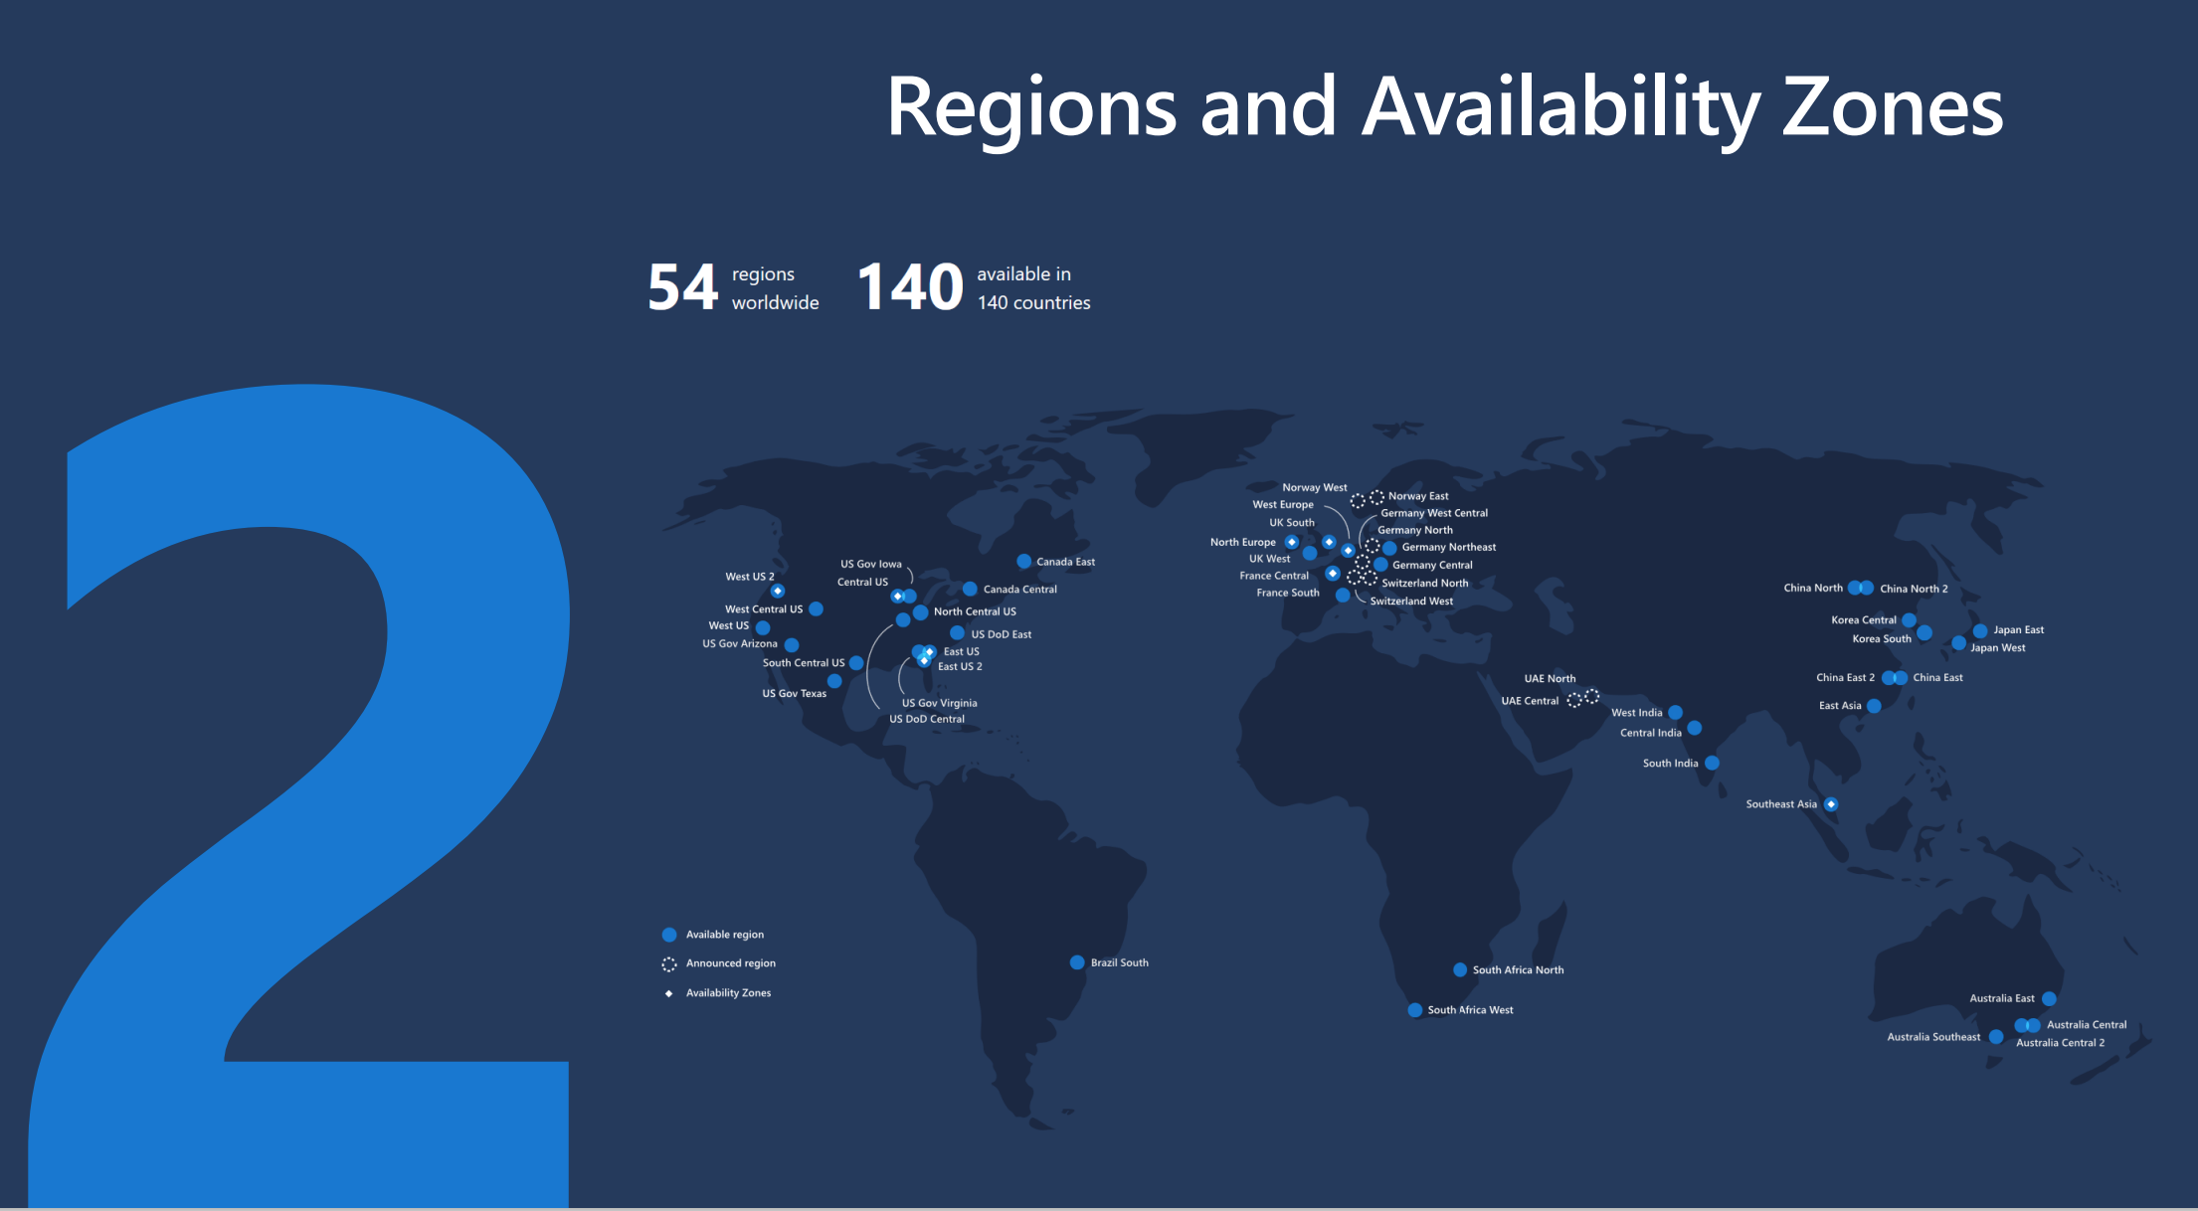

Slide 39
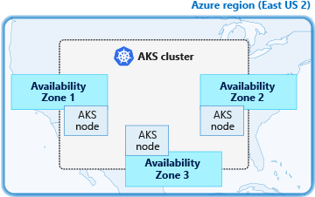
Availability Zones
Availability Zone - Unique physical locations within a region. Each zone is made up of one or more datacenters equipped with independent power, cooling, and networking.
Zone-redundant services distribute your applications across Availability Zones to protect from singlepoint-of-failure
Availability zones are not available in all Regions

Slide 40
Cluster Node Pools
A Node Pool in a set of Nodes (VMs) with the exact same configuration.
In AKS, each Node Pool maps to a Virtual Machine Scale Set.
Every AKS cluster contains at least one Node Pool.
A default Node Pool is created when a new AKS cluster is provisioned.
The default Node Pool is designated as a System Node Pool, for running Kubernetes utilities.
System Nodes should not be confused with Master Nodes, which control the Kubernetes cluster and are hidden.
You have no control over the configuration and number of Mater Nodes.
While you can schedule your workloads on system nodes, it’s recommended that you create a separate User Node Pool to run your Pods

Slide 41
Types of Node Pools
AKS supports several types of Node Pools:
System Node Pool – Used by system utilities like CoreDNS and Metrics Server. System Node Pools can only use the Linux OS.
Linux User Node Pool – Pool of VMs that can run user workloads requiring the Linux OS.
Windows User Node Pool - Pool of VMs that can run user workloads requiring the Window 2019 OS.
Spot Node Pool – A User Node Pool that consists of Spot VM Instances. Azure can reclaim these VMs at any time if it needs their compute power. Spot VMs are up to 90% cheaper than regular VMs. These are great for “expensive” workloads that are resilient enough to tolerate being deleted and recreated as Nodes are removed and reattached.
Virtual Nodes – Dynamic nodes created as wrappers for Azure Container Instances. One node is created for each Pod it hosts. See limitations.

Slide 42
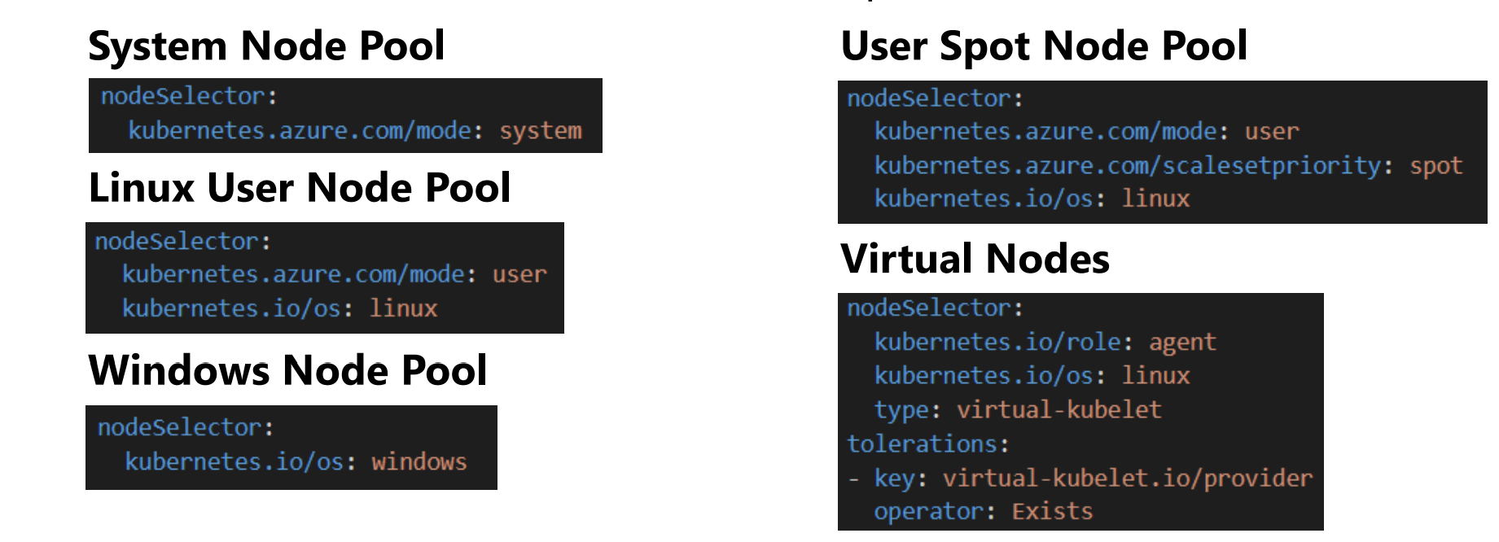
Labels and Node Selectors
Leverage well-known, prepopulated node labels and node selectors to ensure your workloads are scheduled in the correct node pools.
You can also automatically add custom labels to every node in a node pool and implement your own node selection criteria

Slide 43
Labels and Node Selector
Module2-instructions (Optional)
Exercise: Deploying Workloads to Nodes
Notes:
Module2-instructions
Exercise: Deploying Workloads to Nodes

Slide 44
Right-Sizing VM Sizes
The number and size of VMs in a clusters will depend on your system requirements.
Use a smaller VM size for the System Node Pool to minimize costs. For example, using DS2_v2 nodes with the default 512 GB OS disk are enough for most system workloads.
For User Node Pools, use larger VM sizes to pack the maximum number of pods on a node. This will minimize the footprint of services that run on all nodes, such as monitoring and logging.
Deploy at least 2-3 nodes per node pool. That way, the workload will have a high availability pattern with multiple replicas.
Use the Cluster Autoscaler to have AKS automatically adjust node counts based on demand instead of always having enough nodes available to handle peak loads.
When planning capacity for your cluster, assume that your workload can consume up to 80% of each node; the remaining 20% is reserved for AKS services.
If the node sizes/counts don’t meet your needs, you can reconfigure them at any time.

Slide 45
Scaling Nodes
Module2-instructions (Optional)
Exercise: Scaling Nodes to Meet Demand
Notes:
Module2-instructions
Exercise: Scaling Nodes to Meet Demand

Slide 46
Kubernetes Namespaces
Kubernetes supports multiple virtual clusters backed by the same physical cluster. These virtual clusters are called namespaces.
Namespaces are intended for use in environments with many users spread across multiple teams, or projects.
Namespaces provide a scope for resources. Resource names can be reused across namespaces.
Get a list of Namespaces:
kubectl get namespaces
Get a list of Pods in a namespace
kubectl get pods –n mynamespace

Slide 47
Use Namespace to Separate Resources
Namespaces be used to segment resources by:
Environments – Ex: Development resources can be in one namespace, Staging in another.
Applications – Ex: Shopping cart microservices in one namespace, Marketing in another.
Developers – Ex: Each developer can have their own, isolated workspace.
User permissions/resources can be limited by namespace.
To access resources across namespaces, use their FDQN:
Mysql.connect(“db-service.othernamespace.svc.cluster.local”)

Slide 48
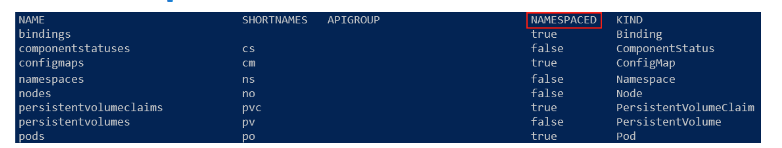
Not all Resources use Namespaces
Most resources are scoped to namespaces, but some are available across the entire cluster.
Get a list of available namespace and cluster-scoped resources:
kubectl api-resources
Filter list of resources by namespaced scope:
kubectl api-resources --namespaced=true

Slide 49
Namespaces Demo

Slide 50
Azure Container Registry
When running containers in AKS, you can pull their images from any container registry, if you have a Docker Secret configured in your cluster.
Azure offers a private container registry as a service called Azure Container Registry (ACR).
Build, store, secure, scan, replicate, and manage container images and artifacts with a fully managed, geo-replicated instance of ACR.
Benefits of using ACR instead of a public registry:
You can import images from public registries
You can block unauthorized access to your images.
You won't have public facing dependencies (in case a public image is deleted).
You can access image pull logs to monitor activities and triage connectivity issues.
Take advantage of integrated container scanning and image compliance using Microsoft Defender for Containers.

Slide 51

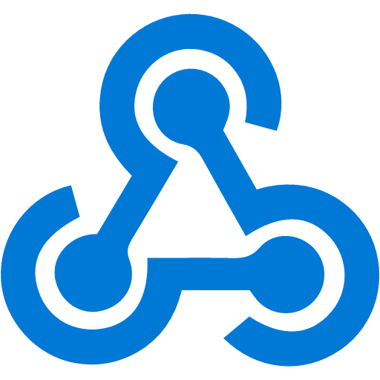
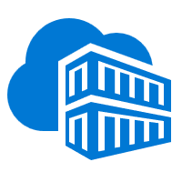
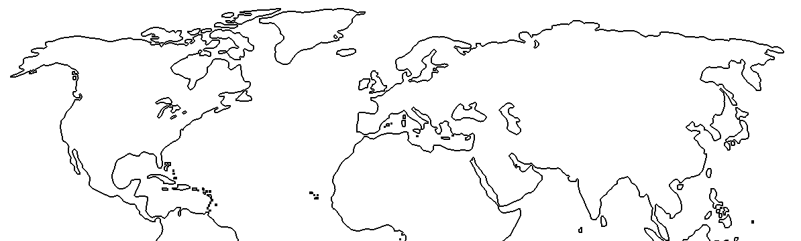
Azure Container Registry geo-replication
Push image to a single registry and ACR takes care of geographical replication, including local notifications.
Container image
Developer
͏US-based developer commits codes to build container image
1
</>
Image is pushed to the nearest Azure Container Registry (ACR) region based on DNS
3
5
East US
contoso.azurecr.io
contoso.azurecr.io
West Europe
2
͏Geographical webhook triggers deployment to East US
AKS
CD
ACR
ACR
CD
AKS
͏ACR geo-replicates to configured regions
Geo-Replication
͏Geographical webhook triggers deployment to West Europe
contoso.azurecr.io/app:v1
4
contoso.azurecr.io/app:v1
6
6
͏Both AKS clusters pull from contoso.azurecr.io
Notes:
Feature benefits
Manage a single registry across all regions: contoso.azurecr.io
Manage a single configuration of image deployments as all regions used the same image URL: contoso.azurecr.io/app:v1
Push to a single registry, while ACR manages the geo-replication, including regional webhooks for local notifications
No need to configure registry access for each region
Eliminates the need for development teams to push images to different registries and configure/maintain each regional deployment with image names referencing the local registry
Reduced egress fees for remote clusters

Slide 52
ACR Demo
Module3-Instructions
Exercise: Create ACR and Sample Workload Image
Notes:
Module3-Instructions
Exercise: Create ACR and Sample Workload Image

Slide 53
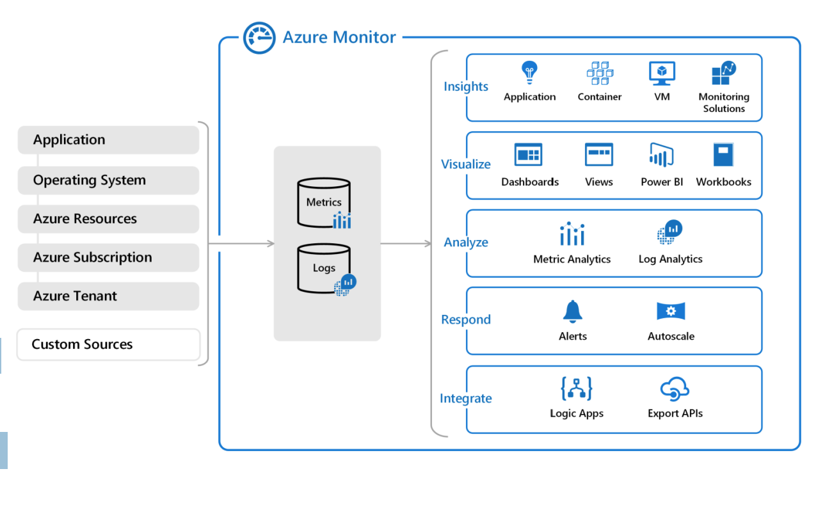
Azure Monitor
Azure Monitor helps you maximize the availability and performance of your applications and services.
It delivers a comprehensive solution for collecting, analyzing, and acting on telemetry from your cloud and on-premises environments.
Most Azure resources can send their telemetry to Azure Monitor.

Slide 54
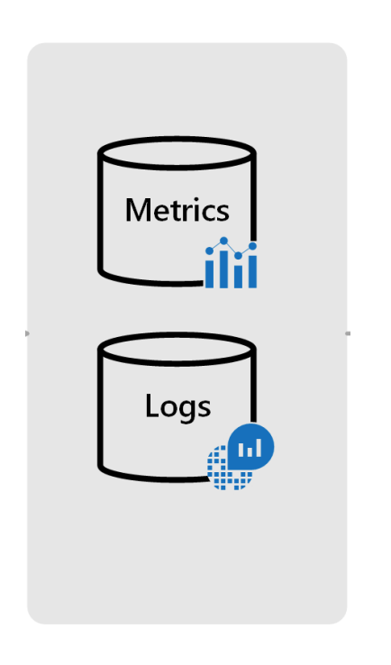
Log Analytics Workspace
A Log Analytics Workspace is a centralized databases that stores metrics and logs from AKS clusters.
You can create a Log Analytics Workspace when you create an AKS cluster or leverage an existing instance.
Log Analytics Workspace instances are identified by a Workspace ID.
OMS Agents (Pods created on each Node by a DeamonSet) monitor nodes and send telemetry data to a Log Analytics Workspace instance*.
*Note: Node metrics are not available from Virtual Nodes.

Slide 55
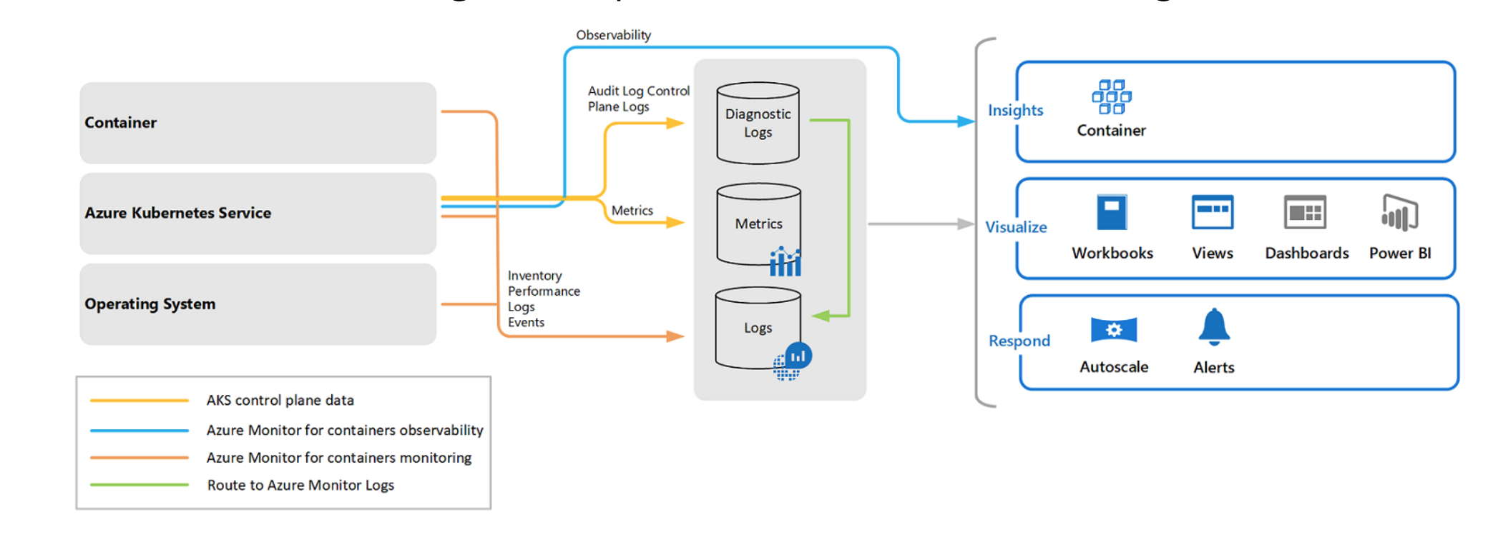
Azure Container Insights
Azure Container Insights is a part of Azure Monitor and integrates with AKS.
See How to query logs from Container Insights for sample Kusto queries.

Slide 56
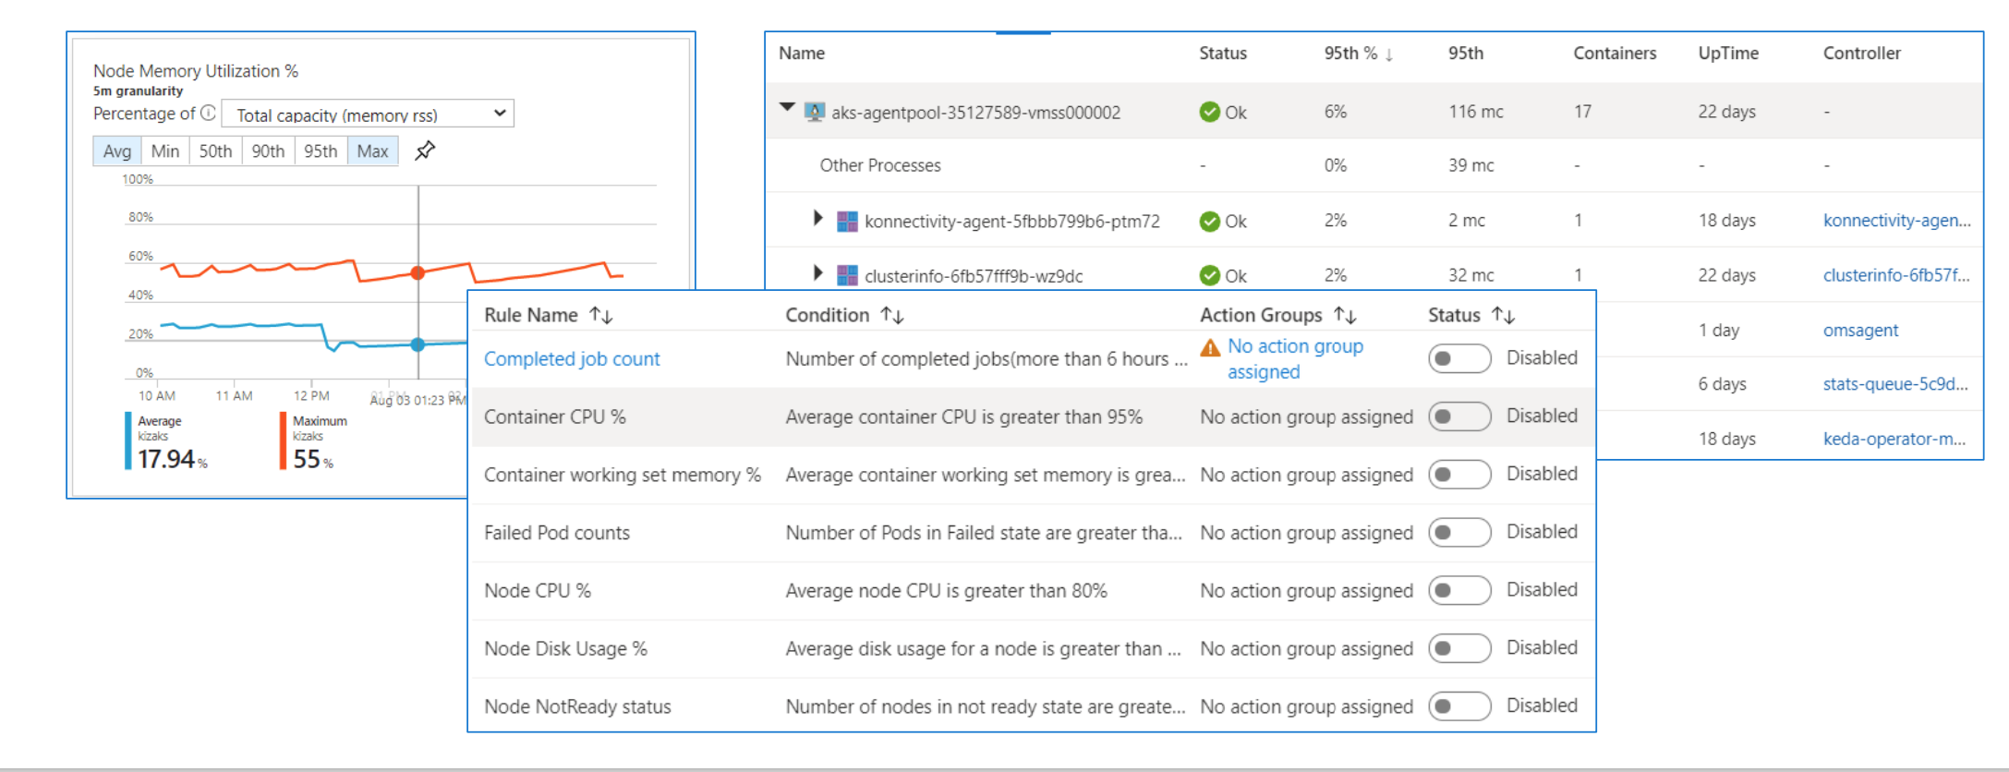
Azure Container Insights Dashboard
Container Insights allows you observe many aspects of your cluster and create alerts for critical events.

Slide 57
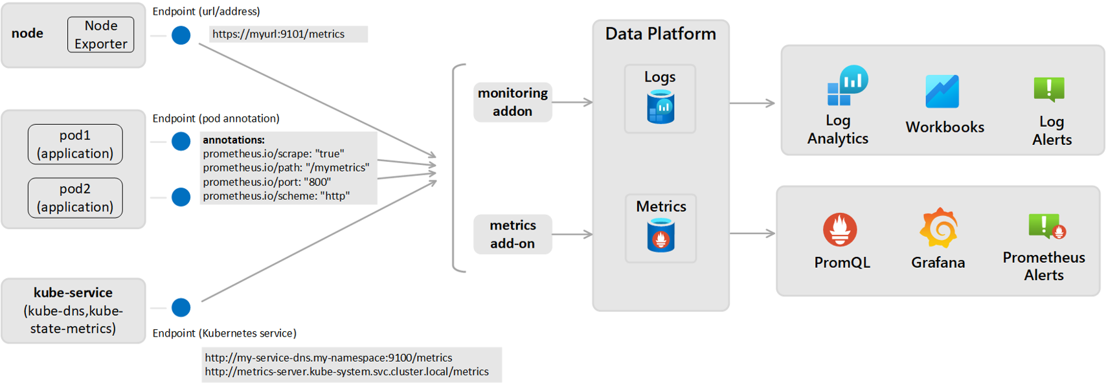
Monitor AKS with Azure Monitor Managed service for Prometheus and Container Insights

Slide 58
Monitor AKS with Azure Monitor Managed service for Prometheus and Azure Managed Grafana - Setup
Enable Managed Identity for your AKS Cluster​
Create an Azure Monitor Workspace​
The following resource providers must be registered in the subscription of the AKS cluster and the Azure Monitor Workspace.​
Microsoft.ContainerService​
Microsoft.Insights​
Microsoft.AlertsManagement​
Create a Grafana Workspace​
Enable Prometheus Metric Collection​
Verify Deployment ​
Link a Grafana Workspace

Slide 59
Monitor AKS with Azure Monitor Managed service for Prometheus and Container Insights- Setup
Enable Managed Identity for your AKS Cluster​
Create an Azure Monitor Workspace​
The following resource providers must be registered in the subscription of the AKS cluster and the Azure Monitor Workspace.​
Microsoft.ContainerService​
Microsoft.Insights​
Microsoft.AlertsManagement​
Send Prometheus data to Azure Monitor Logs​
Query Prometheus Metrics in Log Analytics Workspace​
Create Prometheus Rules

Slide 60
Azure Container Insights
Module2-Instructions
Exercise: Examine Container Insights
Notes:
Module2-Instructions
Exercise: Examine Container Insights

